Slide 1


Machine Learning — Deployment | Recomendation Home Pricing Using Unsupervised K-Means (Clustering)
Machine Learning Process - Sekolah Data Pacmann
pacmann.io
© 2022 – Pacmann AI

Slide 2
Outline
Introduction
Datasets Description
Problem Statements and Goals
Ekspolatory Data Analysis (Correlation and Hipotesis)
Modeling
Diagram flow
Deployment
Conclution
Notes

Slide 3
Introduction
Notes:
Transisi antar outline

Slide 4
Introduction
In the website rumah123 provide service home pricing or home rent, home sold base on facility, wide, and location. At the moment the service, user still search manual without give feauture need that want to search like how many wide of land that want it, facility, and home pricing or installment. Therefore so that user can search need home that needed more simplify, then a recommendation system built for purpose business. The system based using machine learning with unsupervised clustering method so that can clustering feauture that needed from user, and the company can reduce operational cost because can cluster big data. The system wil focus in the Malang City with descriptive on region ward, subdistrict, and city. The system can be access to public later.

Slide 5
Datasheets
Notes:
Transisi antar outline

Slide 6
Datasheets
Price : Home Price in Malang Bedroom : Sum of Bedroom Bathroom : Sum of Bathroom Land : Wide all land that sold (m2) Building : Built-up area (m2) Garage : Sum of garage on home Important places : R The home include near important place or no (Note : Important Places= Campus, Health, View, dan supermarket) Location : The home include regions ward, subdistrict, and city. Installment_BCA : Home installment per month if using BCA Bank with DP 20 %
Installment_BNI : Home installment per month if using BNI Bank with DP 20 % Installment_Mandiri : Home installment per month if using Mandiri Bank with DP 20 % Floor : The home have floor 1, 2, or 3

Slide 7
Problem Statements and Goals
Notes:
Transisi antar outline

Slide 8
Problem Statements
Problem Statement
Objective Question :
How to Eksploratory Data Analyst (hypothesis and Correlation) ?
How to make system recommendation for user ?
How to user can know which is recommendation that suitable his needs?
3. How can users access the system?

Slide 9
Goals
The objectives to be achieved are: 1. Can know data pattern throught Eksploratory Data Analyst
2. Can make it easy user in Conduct a home search as needed. 3. Can reduce cost business for determine need customer with know cluster (pattern data) that suitable with need.

Slide 10
Eksploratory Data Analyst
Notes:
Transisi antar outline

Slide 11
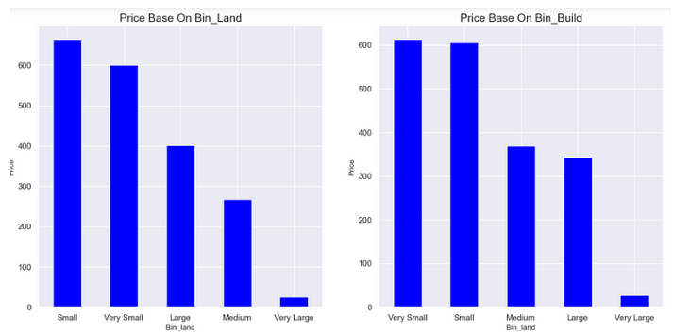
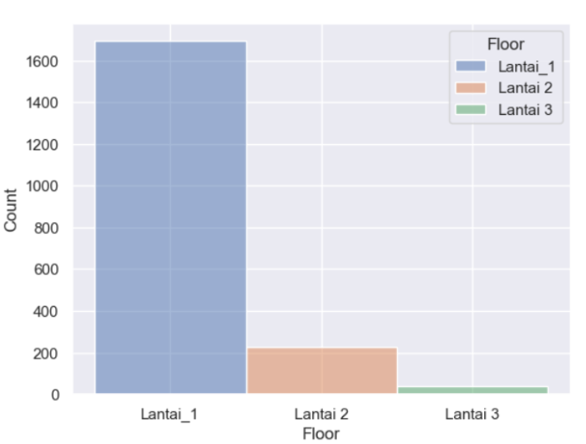
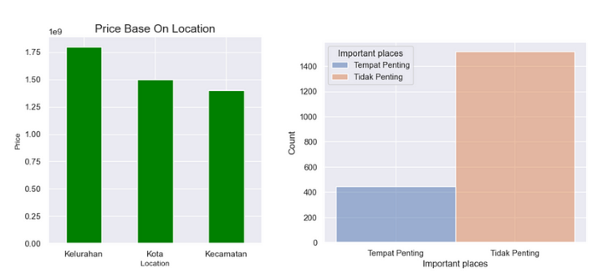
Eksploratory Data Analyst

Slide 12
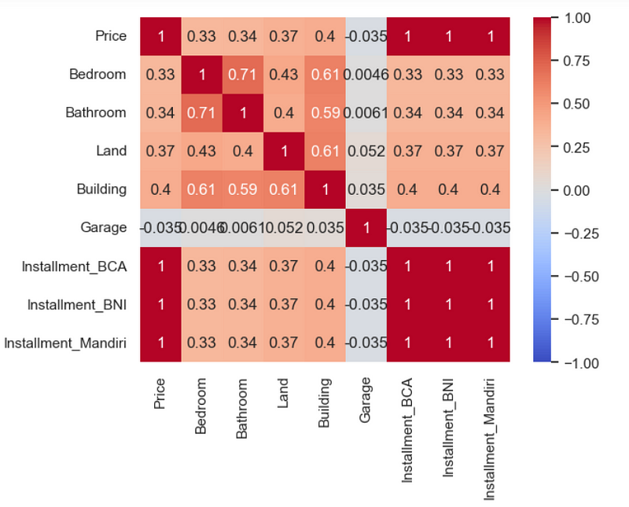
Eksploratory Data Analyst (Correlation)
Chi-squre Method (Category vs Category) :
Data < p-value, the result mean columns between columns category have correlation.
Spearman Method (Numeric vs Category) :
The result of correlation very low with means correlataion as big 0.0..
Anova Method (Correlation indipendent vs dependent (few columns) :
The result correlation Anova 2 category (n) vs 1 numeric column (floor and Important Places ) that have < p-value is bedroom (0.002) and bathroom (0.0008).
Kernel Method (Numeric VS Numeric) :
Linier Regression
price = 3.016e+09 + 1.086e+08 (Bedroom) + 5.084e+07 (Bathroom) + 1.009e+07 (Building (m²)) — 2.811e+08 (Garage) — 3.211e+04 Land (m²)

Slide 13
Eksploratory Data Analyst (Hypotesis)
Important places - Revalue between class 0 and class 1 for statistically significant
prices Floor - Rerate between class 0 and class 1 for price then reject h0

Slide 14
Modeling
Notes:
Transisi antar outline

Slide 15
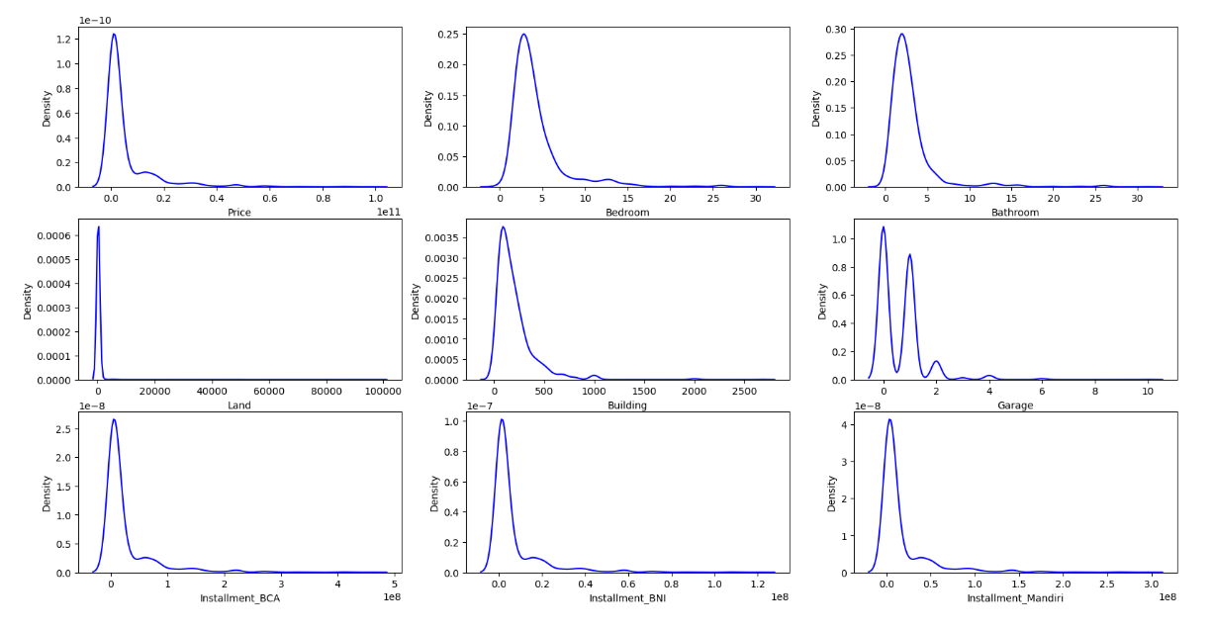
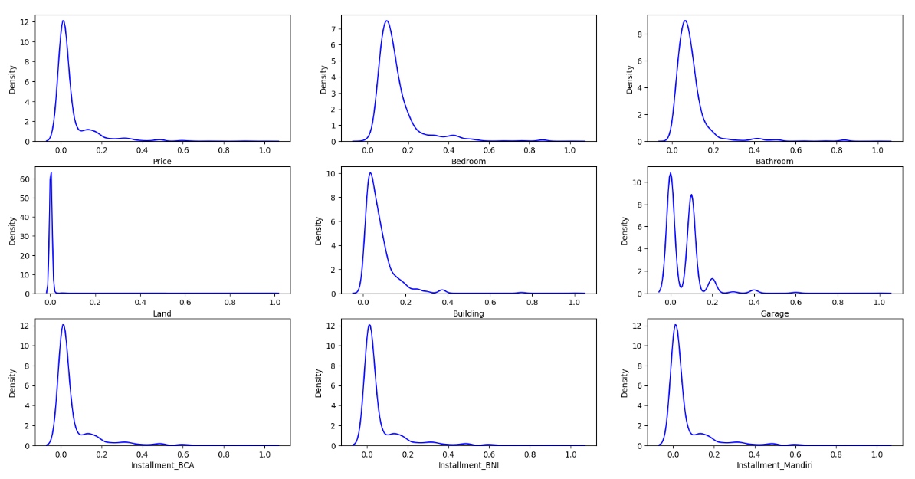
Modeling Unsupervised (K-means)
Choose feauture engineering using Minmax Scaller
Distribution Data Before Scalling
Distribution Data After Scalling Minmax
Sample Data Numeric Before Scalling
Sample Data After Scalling Minmax

Slide 16
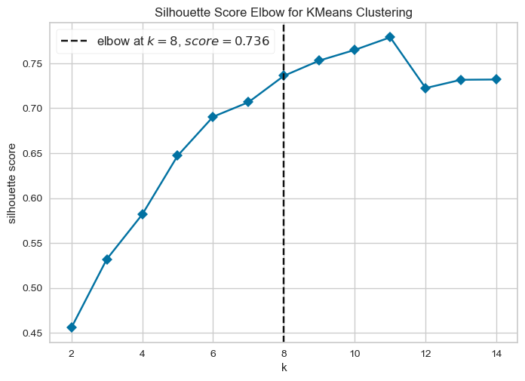
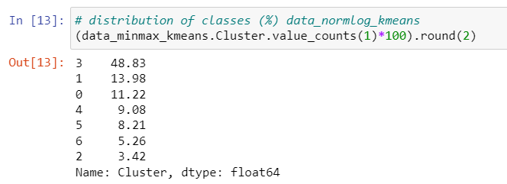
Modeling Unsupervised (K-means)
Best Cluster from Minmax Scaller :
Best Cluster from Minmax Scaller is 7 cluster with score Silhouette
0.79. And Then we check percentage data from cluster.

Slide 17
Modeling Unsupervised (K-means)
Interpretation Cluster (Insight) :
Cluster 0 : Median : Price = 1300000000, Bedroom = 3, Bathroom = 2, Land = 135 (m2), Building = 126 (m2), Garage = 1, Installment_BCA = 6066666, Installment_BNI = 1594666, Installment_Mandiri = 3900000. Modus : Important places = Tidak Penting, Location =Kecamatan, dan Floor = Lantai_1 . Min — Max Values : Bedroom & Bathroom= 0–30/31 , Land = 10–99506, Building = 0 — 2020, Garage = 0 -10, Installment_BCA = 32666–408333333, Installment_BNI = 8586–107333333, dan Installment_Mandiri = 21000–262500000
Cluster 1 : Median : Price = 1550000000, Bedroom = 4, Bathroom = 2, Land = 127 (m2), Building = 150 (m2), Garage = 0, Installment_BCA = 7233333, Installment_BNI = 1901333, Installment_Mandiri = 4650000. Modus : Important places = Tempat Penting, Location =Kecamatan, dan Floor = Lantai_1 . Min — Max Values : Bedroom & Bathroom= 1–23 , Land = 42–1200, Building = 25–2000, Garage = 0 -4, Installment_BCA = 466666–268333333, Installment_BNI = 122666–70533333, dan Installment_Mandiri = 300000–172500000.
Cluster 2: Median : Price = 1800000000, Bedroom = 4, Bathroom = 2, Land = 121 (m2), Building = 190 (m2), Garage = 0, Installment_BCA = 8400000, Installment_BNI = 2208000, Installment_Mandiri = 5400000. Modus : Important places = Tidak Penting, Location =Kecamatan, dan Floor = Lantai_2. Min — Max Values : Bedroom & Bathroom= 1–13 , Land = 42–738, Building = 32–700, Garage = 0 -4, Installment_BCA = 933333–221666666, Installment_BNI = 245333–58266666, dan Installment_Mandiri = 600000–142500000.

Slide 18
Modeling Unsupervised (K-means)
Cluster 3: Median : Price = 1800000000, Bedroom = 3, Bathroom = 2, Land = 148 (m2), Building = 150 (m2), Garage = 1, Installment_BCA = 8400000, Installment_BNI = 2208000, Installment_Mandiri = 5400000. Modus : Important places = Tidak Penting, Location =Kelurahan, dan Floor = Lantai_1. Min — Max Values : Bedroom & Bathroom= 0–26 , Land = 39–937, Building = 34–1000, Garage = 0 -6, Installment_BCA = 1026666–279533333, Installment_BNI = 269866–73477333, dan Installment_Mandiri = 660000–179700000.
Cluster 4: Median : Price = 1400000000, Bedroom = 5, Bathroom = 3, Land = 121 (m2), Building = 200 (m2), Garage = 1, Installment_BCA = 6533333, Installment_BNI = 1717333, Installment_Mandiri = 4200000. Modus : Important places = Tempat Penting, Location =Kota, dan Floor = Lantai_1. Min — Max Values : Bedroom & Bathroom= 1–13 , Land = 49–1102, Building = 70–650, Garage = 0 -3, Installment_BCA = 466666–81666666, Installment_BNI = 122666–21466666, dan Installment_Mandiri = 300000–52500000.
Cluster 5: Median : Price = 1500000000, Bedroom = 4, Bathroom = 3, Land = 144 (m2), Building = 184 (m2), Garage = 0, Installment_BCA = 7000000, Installment_BNI = 1840000, Installment_Mandiri = 4500000. Modus : Important places = Tempat Penting, Location =Kota, dan Floor = Lantai_1. Min — Max Values : Bedroom & Bathroom= 1–20/16 , Land = 54–6734, Building = 0–2000, Garage = 0 -6, Installment_BCA = 466666–291666666, Installment_BNI = 122666–76666666, dan Installment_Mandiri = 300000–187500000.
Cluster 6: Median : Price = 2450000000, Bedroom = 5, Bathroom = 3, Land = 126 (m2), Building = 200 (m2), Garage = 0, Installment_BCA = 11433333, Installment_BNI = 3005333, Installment_Mandiri = 7350000. Modus : Important places = Tempat Penting, Location =Kelurahaan, dan Floor = Lantai_1. Min — Max Values : Bedroom & Bathroom= 2/1–13/12 , Land = 60–1200, Building = 40–2672, Garage = 0 -2, Installment_BCA = 1703333–175000000, Installment_BNI = 447733–46000000, dan Installment_Mandiri = 1095000–112500000.

Slide 19
Diagram Flow
Notes:
Transisi antar outline

Slide 20
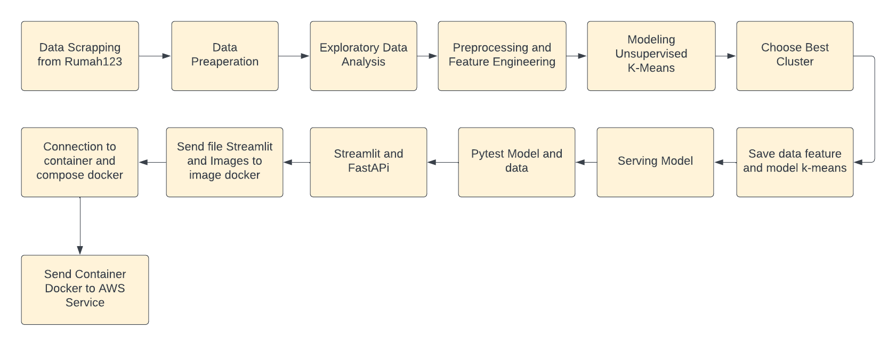
Diagram Flow (General Workflow)

Slide 21
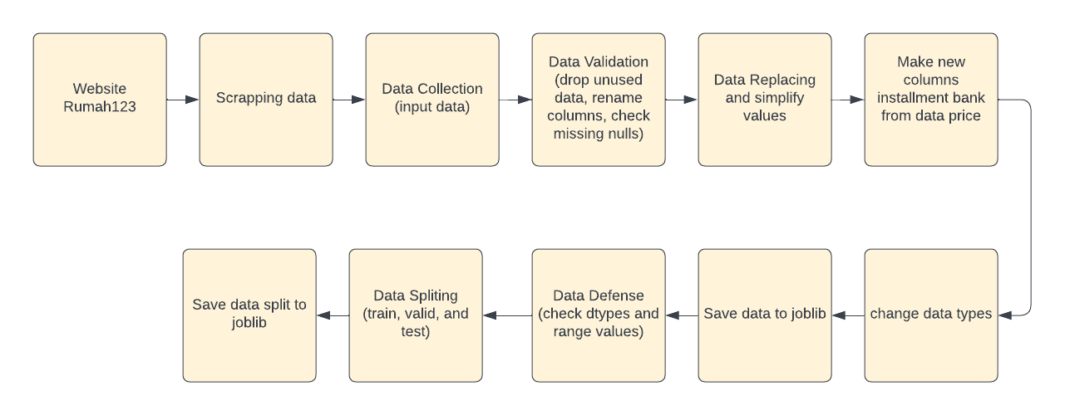
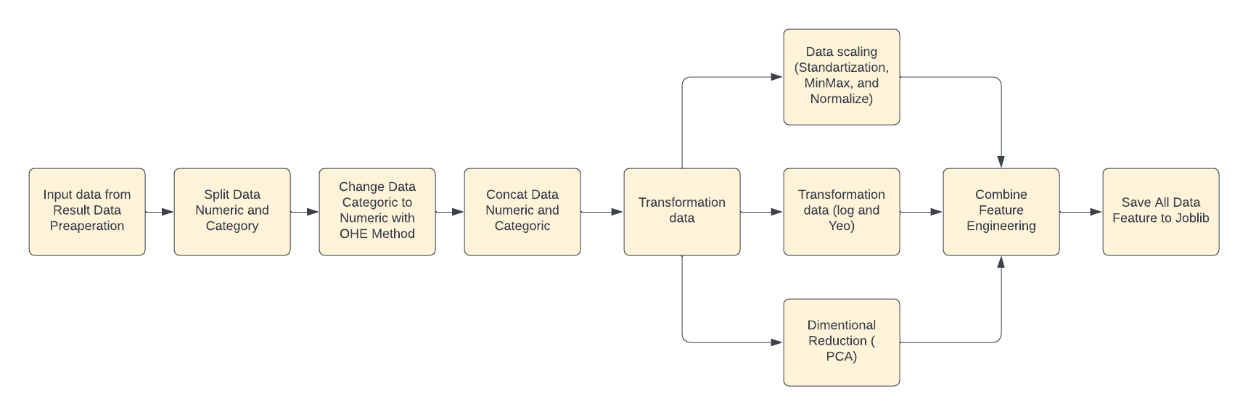
Diagram Flow (Architectures)
Block Diagram Data Preaperation - Pipeline
Block Diagram Data Prepocessing and feauture Engineering

Slide 22
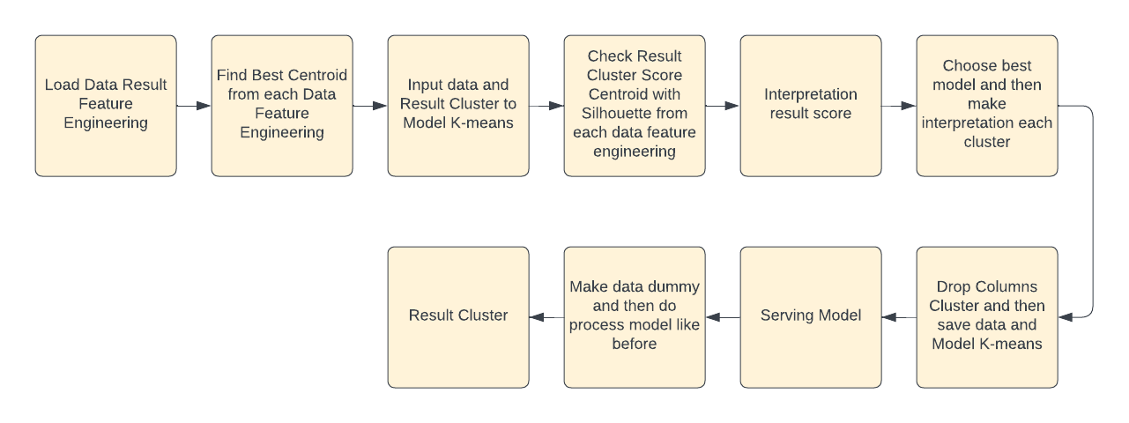
Diagram Flow (Architectures)
Block Diagram Modeling Unsupervised

Slide 23
Deployment
Notes:
Transisi antar outline

Slide 24
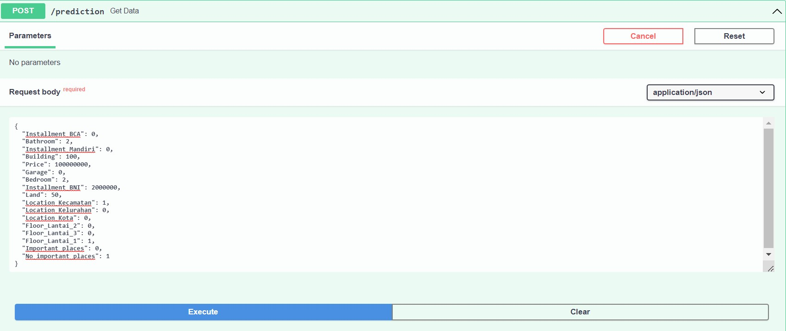

Deployment
{"message":"This is the homepage of the API "}
Output of Prediction is {"prediction Cluster is": 1}

Slide 25
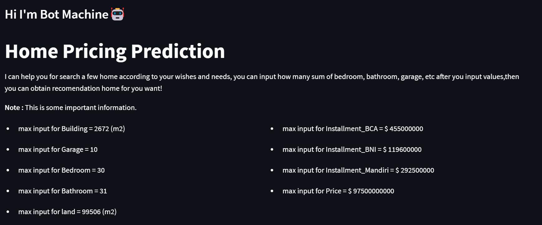

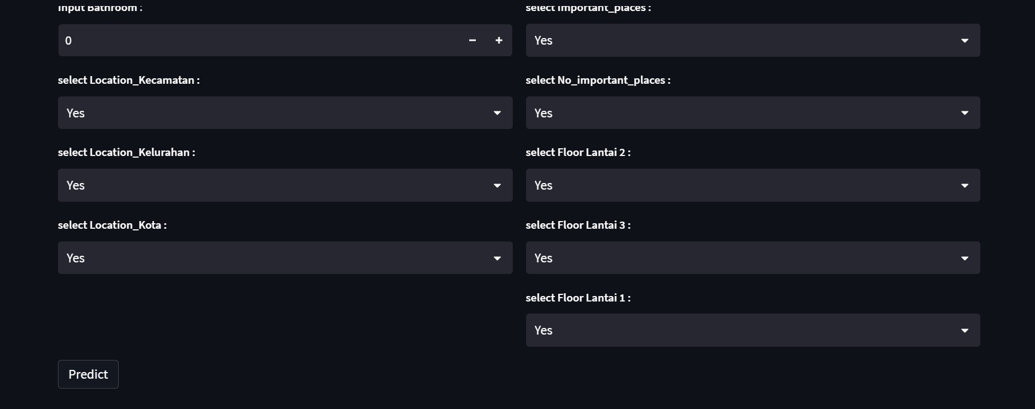
Deployment
Output Streamlit

Slide 26
Deployment (Running in Localhost)
Import/built file Streamlit and FastAPI to Docker Image >> docker built -t (name image) .
Run Container Streamlit and FastAPI >> docker run -p (name images in docker)
Stop Image and container streamlit and FastAPI in the docker
Compose file docker compose >> docker compose up
Run docker compose in new images (fill streamlit and fastapi)
Input data in the streamlit

Slide 27
Conclution
Notes:
Transisi antar outline

Slide 28
Conclution
Using minmax scaller is the best Feature Engineering for K-means Model in this data.
The next project may improve the server, making it publicly accessible
Frontend features can be improved, such as adding user identity and sending input data to the database

Slide 29
Notes
Notes:
Transisi antar outline

Slide 30
Notes
By using this cluster model, companies can provide recommendations according to existing clusters from user input.

Slide 31
Thankyou ^_^
Notes:
Transisi antar outline

